Slide 1





Remote session
Cybersecurity Month
Game presentation
Cyber Investigation
-
Social Engineering
&
Identity Theft

Slide 2
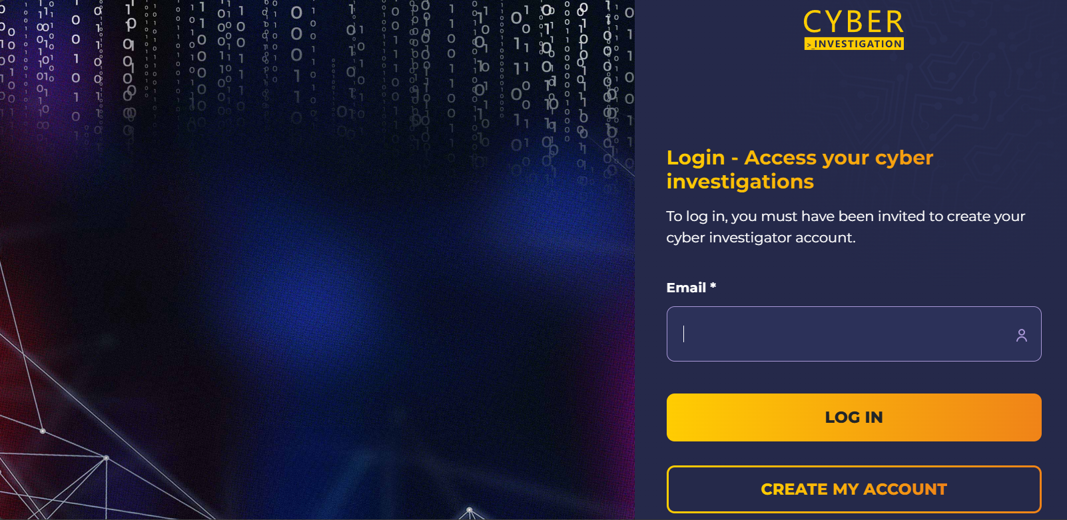

Briefing | Connect to Cyber Investigation & select the right session
Connect through SSO, or create your account if you haven’t done it yet, via the following link: https://cyberinvestigation.fr/saml/orange.
On the platform, select the item “Social Engineering & Identity Teft” with the information matching the session.

Slide 3

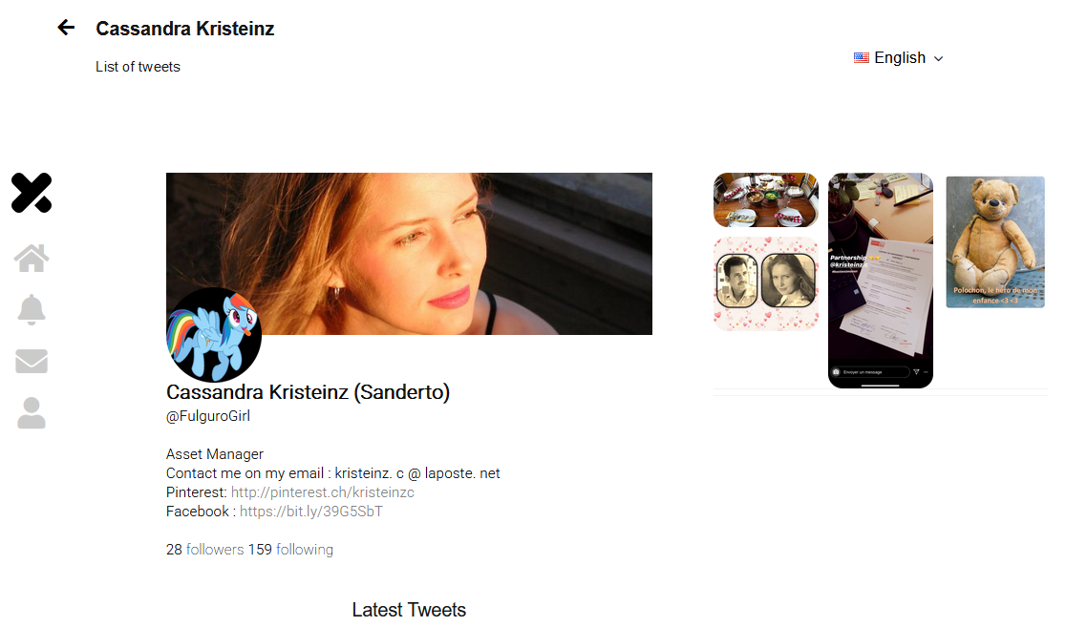



Briefing | Instructions to provide to the participants
Objective:
To better understand how bad practices can jeopardize the group and its employees. This mission highlights how open-source intelligence (OSINT) methods can be used for industrial espionage purposes.
You are going to be directed to Cassandra KRISTEINZ Facebook and Twitter and Facebook page. From there, you will have to start searching for the answers to the first questions and crack the case open.
But First, let’s present you the Cyber Investigation website that will guide you through the investigation.

Slide 4
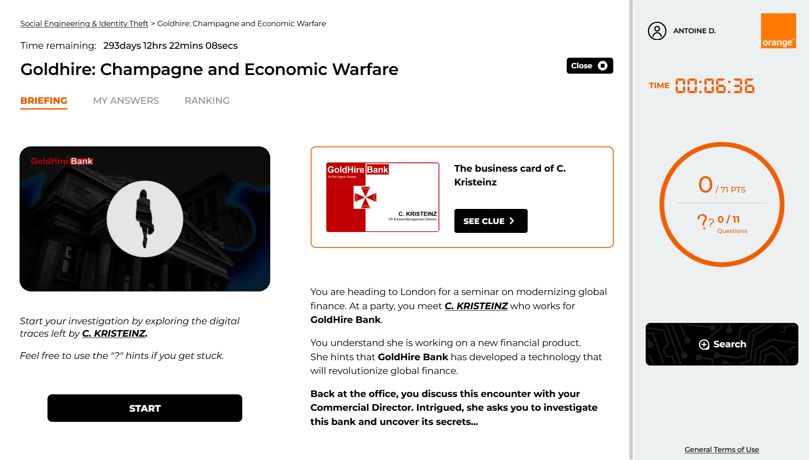
Briefing | Presentation of the environment

Slide 5
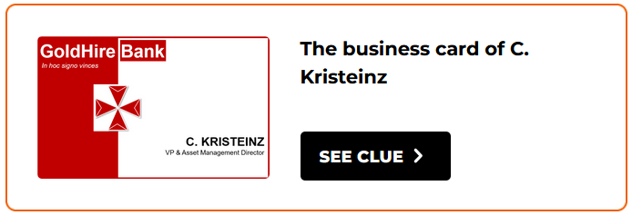



Briefing | Presentation of the environment
The “SEE CLUE” button gives you a first lead to help you start the investigation
The “Search” button opens a new tab and load the virtual environment where you will conduct your investigation.
The “START” button brings you to the page containing all the questions that will guide you through the investigation
WARNING!!! The “Close” button terminates the investigation, and it will be impossible to restart later.

Slide 6
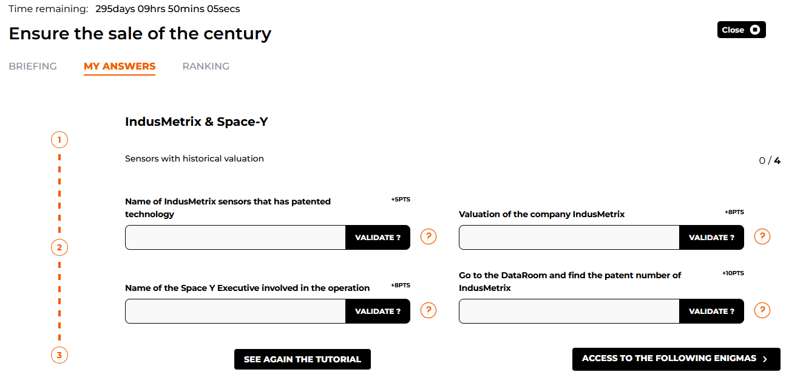
Briefing | Presentation of the environment

Slide 7




Briefing | Presentation of the environment
The number of points awarded for answering the question correctly.
The “Validate ?” button will allow you to check if your answer is correct.
The “?” button will give you a clue to help you answer the question. Using this can sometimes reduce the amount of point gained from answering the question (a pop up will inform you about it).
The “See again the tutorial” button will replay the embedded tutorial.
The “Access to the following enigmas” button will let you skip the unanswered questions and move on to the rest of the investigation.

Slide 8

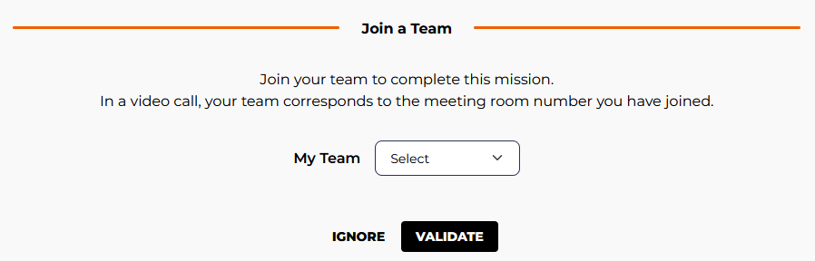
Set-up | Getting ready for the investigation
You can now click on the “Goldhire: Champagne and Economic Warfare” module.
Breakout rooms are about to be created. Once you are dispatched, you need to look at your room number, top-left corner of the Teams window, this is the team number you need to select on the pop-up screen.
One member from each team should share their screen to facilitate teamwork. Everyone needs to answer the questions on their own computer to maximise the team score.
Don’t forget to be curious!
Right click, left click, click everywhere! Search through everything and inspect all the elements when you get to the virtual environment !

Slide 9

Thank you

